Slide 1

Subject: DevOps
Module Number: 2
Module Name: Version Control-GIT
SME NAME: ENTER NAME
SUBMISSION DATE: MENTION DATE
VERSION CODE: TO BE FILLED AT HO
RELEASED DATE: TO BE FILLED AT HO

Slide 2
Version Control-GIT
        Syllabus
GIT Features, 3-Tree Architecture, GIT – Clone /Commit / Push, GIT Hub Projects, GIT Hub Management, GIT Rebase & Merge, GIT Stash, Reset, Checkout, GIT Clone, Fetch, Pull.

Slide 3
Version Control-GIT
        AIM:
Aim of this Module is the practices of version control and configuration management that support DevOps

Slide 4
Version Control-GIT
        Objectives:
The Objectives of this Module is to:
The concept of GIT Features and 3 Tree Architecture
To Implement the GIT Commands

Slide 5
Version Control-GIT
        Outcomes:
At the end of this Module, Students will be able to:
To Learn the GIT Concept
To Learn to apply GIT commands

Slide 6
Version Control-GIT
        Table of Content:
GIT Features, 3-Tree Architecture
GIT – Clone /Commit / Push, GIT Hub Projects
GIT Hub Management, GIT Rebase & Merge
GIT Stash, Reset, Checkout, GIT Clone, Fetch, Pull

Slide 7
Version Control-GIT
        GIT Features
Distributed System
Compatibility
Non-linear Development
Branching
Lightweight
Speed
Open – Source
Reliable
Secure

Slide 8
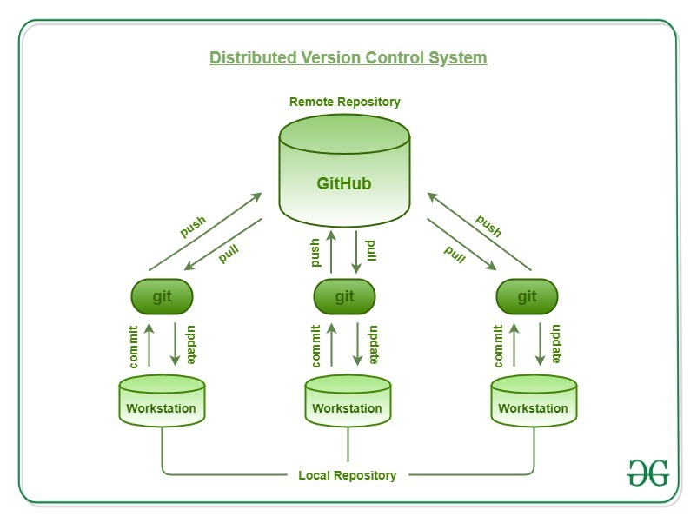
Version Control-GIT
        Distributed System

Slide 9
Version Control-GIT
        Compatibility
Git is a version control system that works with all modern operating systems. Other Version Control Systems, such as SVN, CVK, and others, can also access Git repositories.
These SVNs can build remote repositories that Git can access directly.
Users who were not previously using Git can now switch to Git without having to copy their files from other VCS repositories into Git-VCS. Git can also connect to other VCSs' central repositories.
As a result, one can work on Git-SVN and use the central repository as well. Git provides a CVS server emulation, which allows you to access Git repositories using existing CVS clients and IDE plugins.

Slide 10
Version Control-GIT
        Non-linear Development
Git enables users from all over the world to work on a project from afar.
A user can pick up any component of the project and perform the required operation before continuing to update it.
This is possible thanks to Git's non-linear development nature. Git has capabilities for visualising and navigating a non-linear development history, as well as quick branching and merging.
Git makes the premise that a change will be merged more frequently than it is written. Git keeps track of the project's current state as a Tree.
A new branch can be added to the tree at any moment, and once it's finished, it's merged with the final project.

Slide 11
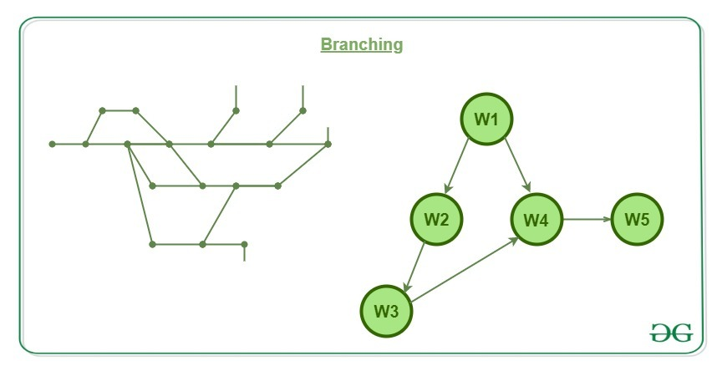
Version Control-GIT
        Branching

Slide 12
Version Control-GIT
        Lightweight
While cloning, Git copies all of the data from the central repository to the local repository. Hundreds of users may be collaborating on the same project, resulting in massive amounts of data in the central repository.
One could be concerned that copying so much data to local machines will cause system failure, however Git has already addressed this issue.
Git uses lossless compression, which compresses data and stores it in a local repository that takes up very little space.
When this data is needed, it uses the reverse procedure, which saves a lot of memory space.

Slide 13
Version Control-GIT
        Speed
In comparison to other version control systems, Git is extremely quick and scalable, allowing for the effective management of huge projects.
The retrieval speed of a local repository is approximately 100 times faster than that of a remote server.
According to a Mozilla test, Git is one order of magnitude faster than other VCS technologies, or around 10 times faster. This is because Git is built in C, which is, unlike other languages, quite similar to Python.

Slide 14
Version Control-GIT
        Open – Source
Git is a free and open-source distributed version management system that can handle small to extremely big projects quickly and efficiently.
It is dubbed open-source because it allows users to edit the source code to meet their specific needs.
Unlike other Version Control Systems, which charge for features like as repository space, code privacy, accuracy, and speed, Git is open-source software that gives all of these features for free, and even better than others.

Slide 15
Version Control-GIT
        Reliable
The data of the central repository is always backed up in every collaborator's local repository by providing a central repository that is cloned each time a User conducts the Pull action.
As a result, even if the central server crashes, the data will never be lost because it can be quickly recovered by any of the developers' local machines.
The data can be recovered by any of the various collaborators once the Central Server has been fully rebuilt.
There's a slim chance that the data isn't available with any developer because the person who worked on the project the most recently will almost certainly have the most recent version of the project on their local machine.

Slide 16
Version Control-GIT
        Secure
On the local copy of the developer, Git keeps track of all the commits made by each collaborator. Each time the push operation is conducted, a log file is maintained and pushed to the central repository.
As a result, if a problem emerges, the developer will be able to quickly identify and resolve it.
Git stores all of the records in the Hash in the form of objects using SHA1.
These Hash keys are used by each object to collaborate with one another.
The commit object is converted into a 14-digit Hex code using the SHA1 cryptographic technique.
It aids in the storage of each developer's commits. As a result, it's simple to figure out which error caused the system to fail.Explanation (Times New Roman-20pt- Line spacing 1.5pt)

Slide 17
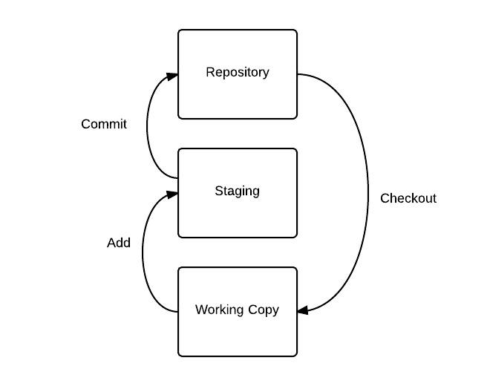
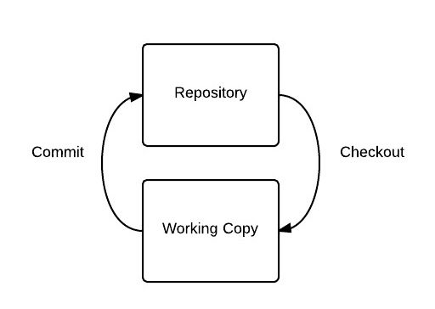
Version Control-GIT
        3-Tree Architecture

Slide 18
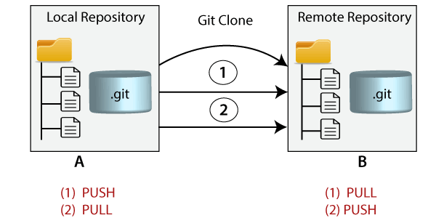
Version Control-GIT
        Git Clone
Cloning is the process of producing a clone of a target repository in Git. The target repository might be either local or remote. You can create a local duplicate of your repository by cloning it from the remote repository. You can also sync your data between the two sites.

Slide 19
Version Control-GIT
        Git Clone Command
The command-line tool git clone is used to create a local copy of a remote repository. It uses a remote URL to access the repository.
Syntax:$ git clone <repository URL>

Slide 20
Version Control-GIT
        Git Clone Repository
Steps to clone a repository are as follows:
Step 1: Launch GitHub and go to the repository's main page.
Step 2: Click Clone or Download next to the repository name.
Step 3: Go to the Clone using HTTPs section and copy the repository's clone URL. You can skip to the following step if you have an empty repository and copy the repository page URL from your browser.
Step 4: Open Git Bash and change the current working directory to the desired location where the local copy of the repository will be created.
Step 5: To make a copy of the remote repository, use the git clone command with the repository URL. Look at the command below:
$ git clone https://github.com/ImDwivedi1/Git-Example.git

Slide 21

Version Control-GIT
        Git Commit
Without any arguments, the commit command will launch the default text editor and prompt for a commit message. In this text editor, we may write our commit message. It will go like this:
$ git commit
We have made a change to newfile1.txt and want it to commit it. It can be done as follows:
Consider the below output:

Slide 22
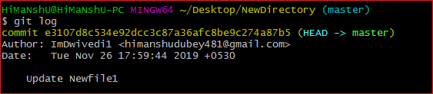
Version Control-GIT
        Git Commit
Press the Esc key, then 'I' to enter insert mode. Put whatever message you wish in the commit message field. To save and quit the editor, press Esc followed by ':wq'. As a result, we've made a successful commit.
The git log command can be used to inspect the commit. Consider the following result:

Slide 23
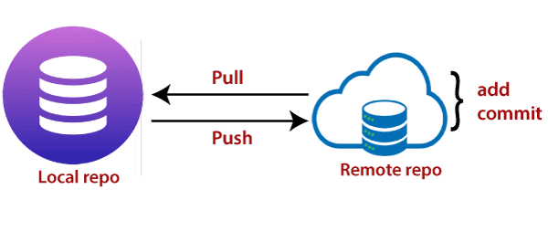
Version Control-GIT
        Git Push
The term "push" refers to the process of copying content from a local repository to a distant repository. The act of pushing commits from your local repository to a remote repository is known as pushing. Pushing has the potential to overwrite changes; caution should be exercised when pushing.

Slide 24
Version Control-GIT
        Git Push
Pushing into the repository is done with the "git push" command. Push can be thought of as a method for transferring commits between local and remote repositories. The following is the basic syntax:
$ git push <option> [<Remote URL><branch name><refspec>...]
Git Push Tags:
<repository>: The repository is where a push action is sent. A URL or the name of a remote repository can be used.
--all: All branches are represented by the word "all." It pulls all branches together.
--dry-run: Dry run tests the commands. It does all this except originally update the repository.
--tags: It pushes all local tags.
--delete: It deletes the specified branch.

Slide 25
Version Control-GIT
        Git Hub
GitHub describes itself as a code storage and version control tool that supports code development cooperation. Each project's code is stored in Repositories, which provide us with a number of tools to aid us in both the creation and administration of the project.

Slide 26
Version Control-GIT
        Git Hub Management
Using GitHub to manage projects is actually rather straightforward. In reality, if you use its components and integrations appropriately, it can make you lot more productive. We know this from personal experience; it's worked for us with teams of up to 15 developers, and there's no reason it can't be expanded any higher.

Slide 27
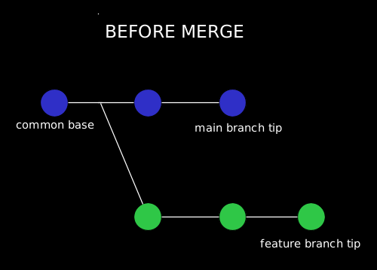
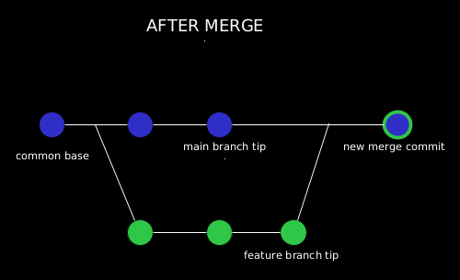
Version Control-GIT
        Git Marge
A merging is a method of reuniting a forked past. The git merge tool allows us to integrate many development branches into a single branch.

Slide 28
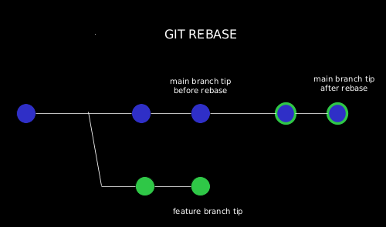
Version Control-GIT
        Git Rebase
A rebase is a method of integrating or migrating a series of commits into a single new base commit. If we think about it in the context of a feature branching workflow, it looks like this:

Slide 29
Version Control-GIT
        Git stash
Usage: git stash save
This command temporarily stores all the modified tracked files.
Usage: git stash pop
This command restores the most recently stashed files.
Usage: git stash list
This command lists all stashed changesets.
Usage: git stash drop
This command discards the most recently stashed changeset.

Slide 30
Version Control-GIT
        Git Checkout
git checkout [branch name]
Switching from one branch to another is done with this command.
git checkout -b [branch name]
This command both creates and switches to a new branch.

Slide 31
Version Control-GIT
        Git Reset
git reset [file]
This command removes the file from the staging area but keeps the file's contents.
git reset [commit]
This command undoes all commits after the specified commit and saves the local changes.

Slide 32
Version Control-GIT
        Git Pull & Fetch
git pull [Repository Link]
This tool pulls updates from a remote server and merges them into your working directory.
git fetch <remote repository><remote branch>
<remote branch> is responsible for retrieving updated modifications from the given branch in the above syntax.

Slide 33
Version Control-GIT
        Self Assessment Question
Which git command can help to stash a change with a message?
      git stash save "message"
      git stash -m "message"
      git stash save -m "message"
      git stash "message"
      Answer: git stash save "message"

Slide 34
Version Control-GIT
        Self Assessment Question
How to create a new branch and switch to it directly?
      $ git checkout <branch-name>
      $ git branch <branch-name>
      $ git checkout -b <branch-name>
      $ git branch -new <branch-name>
      Answer: $ git checkout -b <branch-name> (c)

Slide 35
Version Control-GIT
        Document Link
Topic | URL | Notes
GIT Features, 3-Tree Architecture | https://www.geeksforgeeks.org/git-features/ http://www.darwinbiler.com/understanding-the-3-tree-architecture-of-git/ | Include notes on GIT features and 3 tree architectures
GIT Commands | https://dzone.com/articles/top-20-git-commands-with-examples | Include notes on GIT commands
GIT Hub Projects, GIT Hub Management | https://www.topcoder.com/thrive/articles/project-management-on-github https://everhour.com/blog/project-management-using-github/ | Include notes on GIT hub and management

Slide 36
Version Control-GIT
        Video Link
Topic | URL | Notes
GIT | https://www.youtube.com/watch?v=HVsySz-h9r4 | This videos explain GIT commands

